Slide 1
Central limit theorem

Slide 2
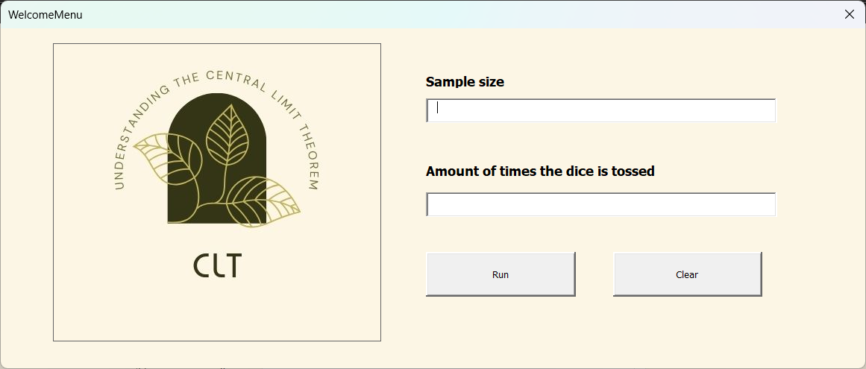
INTRODUCTION
Our application allows you to learn about Central Limit Theorem through dice rolls. You can set the number of rolls and sample size, run experiments, and calculate mean and variance. It also provides reports and visuals to help you understand the results and the impact of sample size on the outcomes.

Slide 3
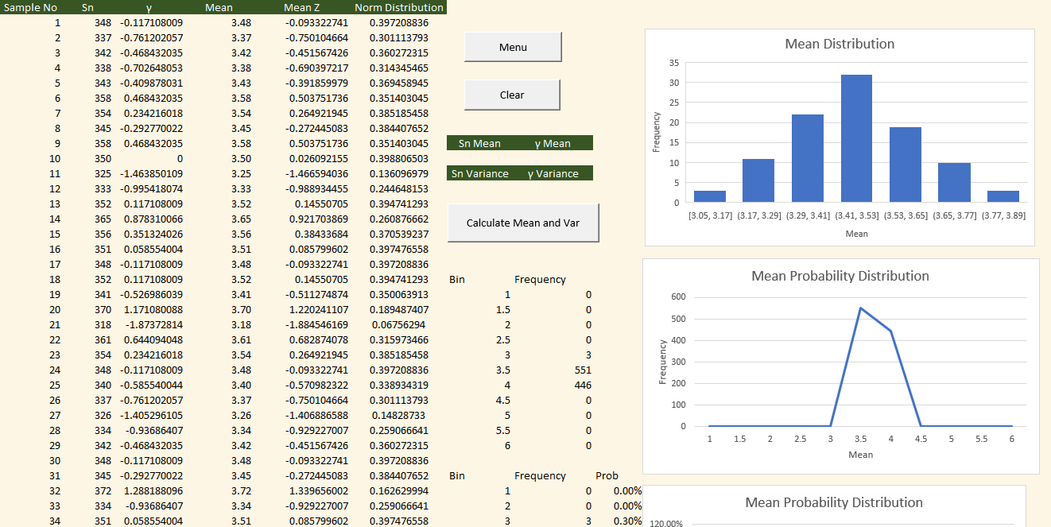
Sample

Slide 4
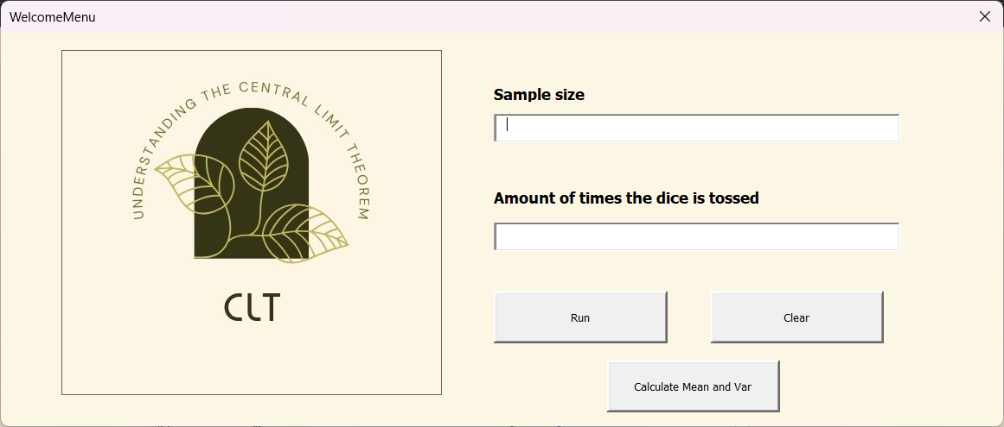
Welcome menu
First, the user needs to enter the sample size and the number of times the dice is tossed in the text boxes. After clicking the 'Run' button, the 'Calculate Mean and Variance' button will become available. Clear button will remove all existing data in the Summary table

Slide 5
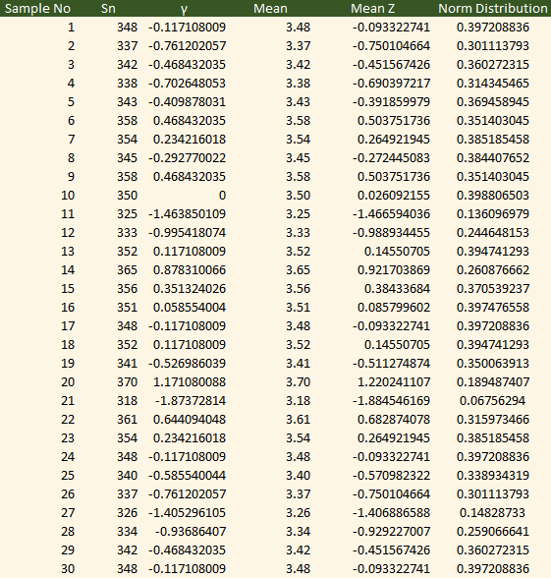
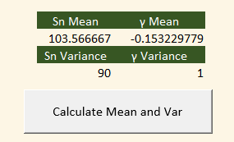
Summary results table
After clicking the 'Run' button, it will display the run number, the sum of the generated numbers, γ, Mean Z, and Norm Distribution for each iteration from 1 to the number of times the dice is tossed that you input. Then you can click the Calculate Mean and Var button to show the mean and variance of Sn and γ

Slide 6
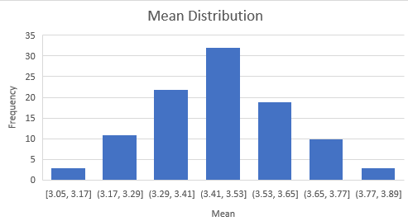
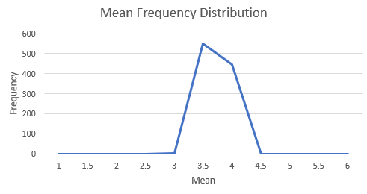
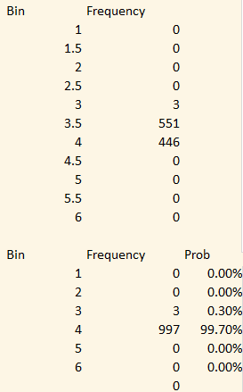
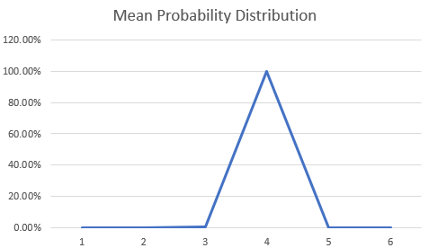
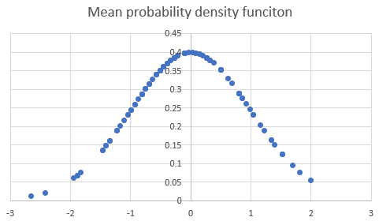
Mean distribution graph
We use the data in the table to create graphs, Mean for Mean Distribution graph, Bin & Frequency for Mean Frequency Distribution graph, Prob for Mean Probability Distribution , Mean Z and Norm distribution for Mean probability density function

Slide 7
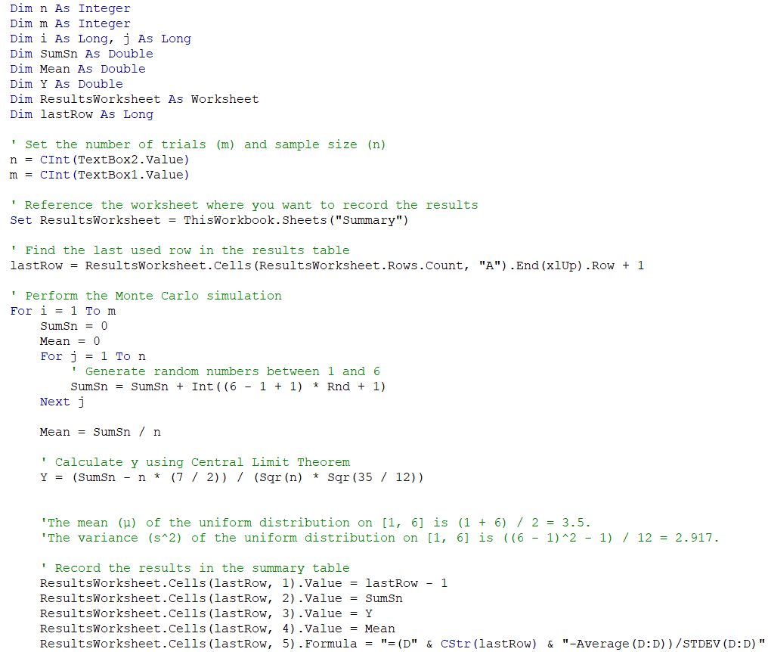
Code

Slide 8
SUMMARY
Our application provides a user-friendly interface for running experiments involving dice rolls and conducting data analysis. Users can specify sample sizes and the number of trials, perform experiments, record results, and conduct statistical analysis. Additionally, it generates reports and plots to visualize the sampling distribution and tests for normality.

Slide 9
THANK YOU
Chanasorn Howattanakulphong 65011277
Phupa Denphatcharangkul 65011462
Pitiphong Kitrueangphatchara 65011472
Pochara Wiangkham 65011476
Sirapop Tuntithanakij 65011528

